Slide 1

CHAPTER 9
COUNTING AND PROBABILITY
Copyright © Cengage Learning. All rights reserved.

Slide 2

9.1
Introduction to Probability
Copyright © Cengage Learning. All rights reserved.

Slide 3
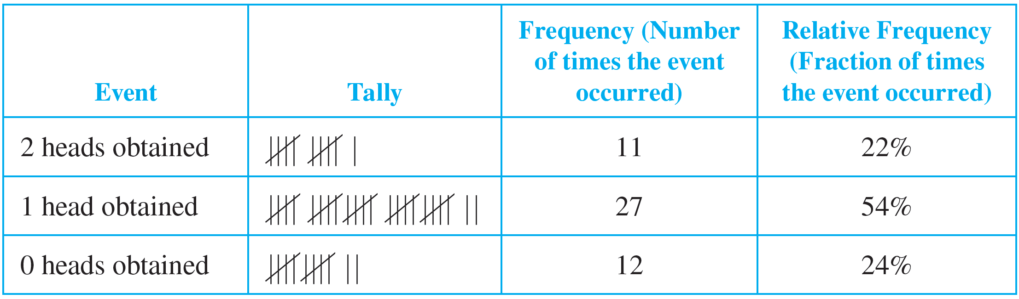
Introduction to Probability
Imagine tossing two coins and observing whether 0, 1, or 2 heads are obtained. It would be natural to guess that each of these events occurs about one-third of the time, but in fact this is not the case. Table 9.1.1 shows actual data obtained from tossing two quarters 50 times.
Experimental Data Obtained from Tossing Two Quarters 50 Times
Table 9.1.1

Slide 4
Introduction to Probability
To formalize this analysis and extend it to more complex situations, we introduce the notions of random process, sample space, event, and probability.
To say that a process is random means that when it takes place, one outcome from some set of outcomes is sure to occur, but it is impossible to predict with certainty which outcome that will be.

Slide 5
Introduction to Probability
For instance, if an ordinary person performs the experiment of tossing an ordinary coin into the air and allowing it to fall flat on the ground, it can be predicted with certainty that the coin will land either heads up or tails up (so the set of outcomes can be denoted {heads, tails}), but it is not known for sure whether heads or tails will occur.

Slide 6
Introduction to Probability
We restricted this experiment to ordinary people because a skilled magician can toss a coin in a way that appears random but is not, and a physicist equipped with first-rate measuring devices may be able to analyze all the forces on the coin and correctly predict its landing position.
Just a few of many examples of random processes or experiments are choosing winners in state lotteries, selecting respondents in public opinion polls, and choosing subjects to receive treatments or serve as controls in medical experiments.

Slide 7
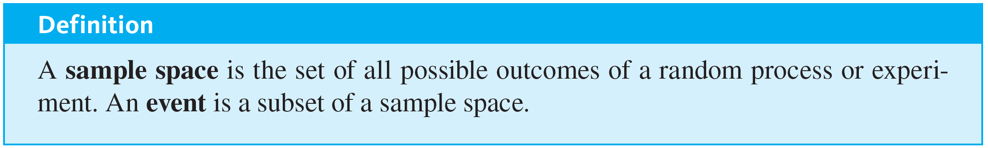
Introduction to Probability
The set of outcomes that can result from a random process or experiment is called a sample space.
In the case where an experiment has finitely many outcomes and all outcomes are equally likely to occur, the probability of an event (set of outcomes) is just the ratio of the number of outcomes in the event to the total number of outcomes.

Slide 8
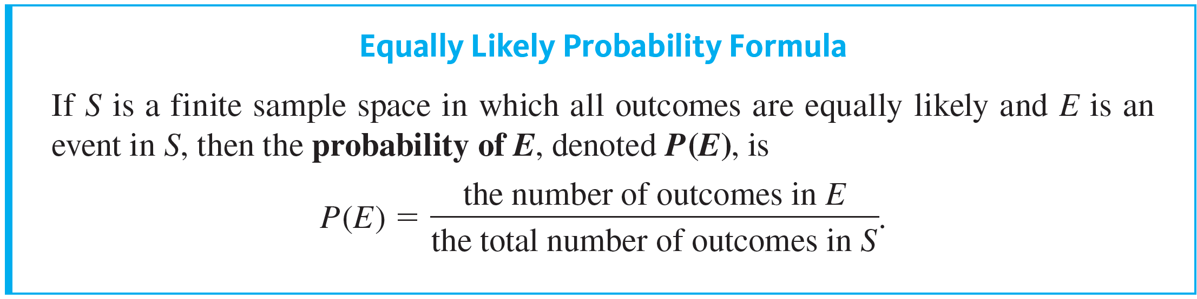
Introduction to Probability

Slide 9

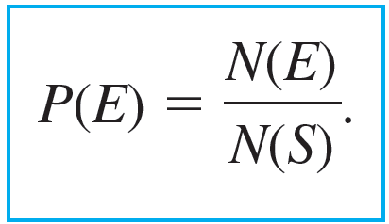
Introduction to Probability
With this notation, the equally likely probability formula becomes

Slide 10
Example 9.1.1 – Probabilities for a Deck of Cards
An ordinary deck of cards contains 52 cards divided into four suits. The red suits are diamonds (♦) and hearts (♥), and the black suits are clubs (♣) and spades (♠).
Each suit contains 13 cards of the following denominations: 2, 3, 4, 5, 6, 7, 8, 9, 10, J (jack), Q (queen), K (king), and A (ace). The cards J, Q, and K are called face cards.
Mathematician Persi Diaconis, working with David Aldous in 1986 and Dave Bayer in 1992, showed that seven shuffles are needed to “thoroughly mix up” the cards in an ordinary deck.

Slide 11
Example 9.1.1 – Probabilities for a Deck of Cards
continued
In 2000 mathematician Nick Trefethen, working with his father, Lloyd Trefethen, a mechanical engineer, used a somewhat different definition of “thoroughly mix up” to show that six shuffles will nearly always suffice.
Imagine that the cards in a deck have become—by some method—so thoroughly mixed up that if you spread them out face down and pick one at random, you are as likely to get any one card as any other.

Slide 12
Example 9.1.1 – Probabilities for a Deck of Cards
continued
a. What is the sample space of outcomes?
b. What is the event that the chosen card is a black face card?
c. What is the probability that the chosen card is a black face card?

Slide 13
Example 9.1.1 – Solution
a. The outcomes in the sample space S are the 52 cards in the deck.
b. Let E be the event that a black face card is chosen. The outcomes in E are the jack, queen, and king of clubs and the jack, queen, and king of spades. Symbolically:
E = {J♣, Q♣, K♣, J♠, Q♠, K♠}.

Slide 14
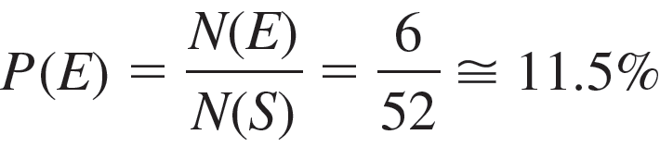
Example 9.1.1 – Solution
continued
c. By part (b), N(E) = 6, and according to the description of the situation, all 52 outcomes in the sample space are equally likely. Therefore, by the equally likely probability formula, the probability that the chosen card is a black face card is

Slide 15
Counting the Elements of a List

Slide 16
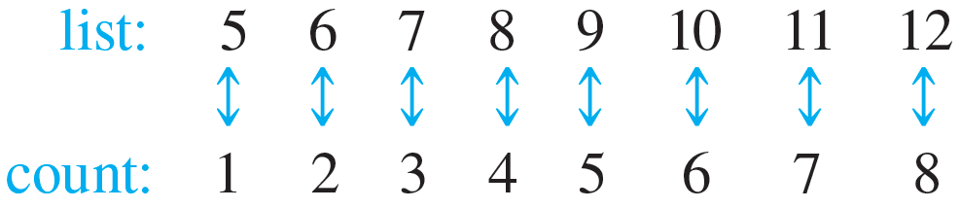
Counting the Elements of a List
Some counting problems are as simple as counting the elements of a list. For instance, how many integers are there from 5 through 12? To answer this question, imagine going along the list of integers from 5 to 12, counting each in turn.
So the answer is 8.

Slide 17
Counting the Elements of a List
More generally, if m and n are integers and m ≤ n, how many integers are there from m through n? To answer this question, note that n = m + (n − m), where n − m ≥ 0 [since n ≥ m].
Note also that the element m + 0 is the first element of the list, the element m + 1 is the second element, the element m + 2 is the third, and so forth.

Slide 18
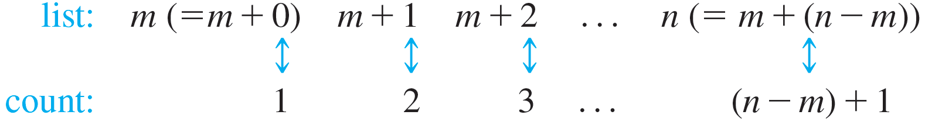
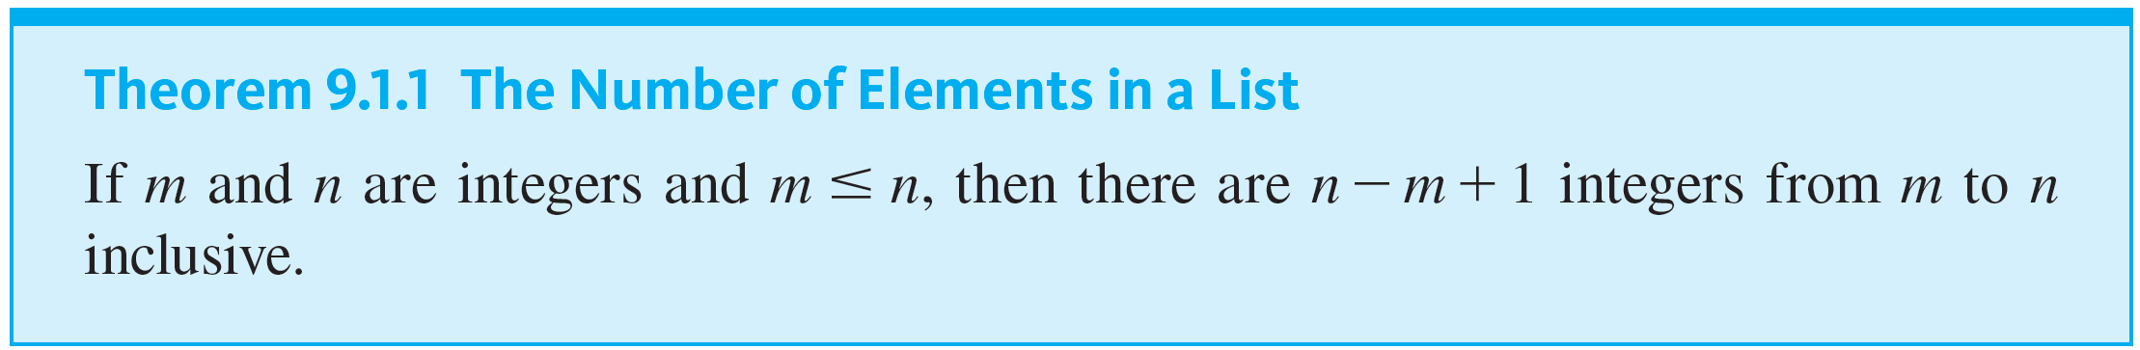
Counting the Elements of a List
In general, the element m + i is the (I + 1)st element of the list.
And so the number of elements in the list is n − m + 1.

Slide 19
Example 9.1.4 – Counting the Elements of a Sublist
a. How many three-digit integers (integers from 100 to 999 inclusive) are divisible by 5?
b. What is the probability that a randomly chosen three-digit integer is divisible by 5?

Slide 20
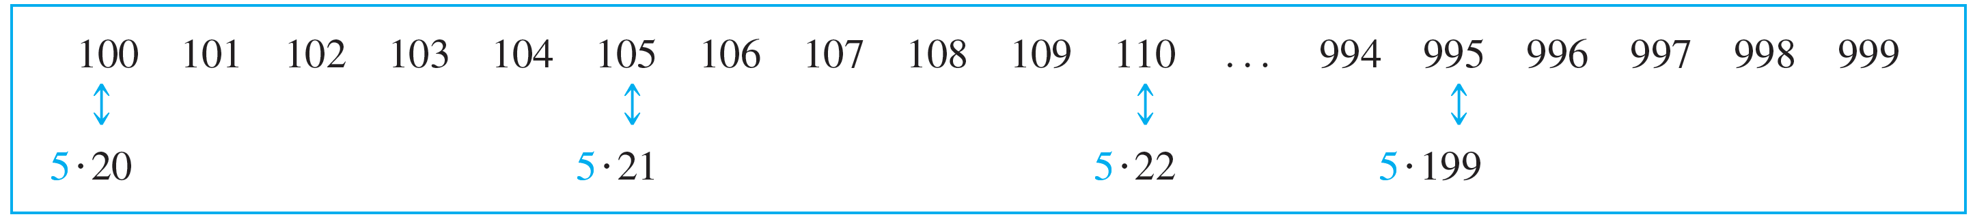
Example 9.1.4 – Solution
a. Imagine writing the three-digit integers in a row, noting those that are multiples of 5 and drawing arrows between each such integer and its corresponding multiple of 5.
From the sketch it is clear that there are as many three-digit integers that are multiples of 5 as there are integers from 20 to 199 inclusive.

Slide 21
Example 9.1.4 – Solution
continued
By Theorem 9.1.1, there are 19922011, or 180, such integers. Hence there are 180 three-digit integers that are divisible by 5.
b. By Theorem 9.1.1 the total number of integers from 100 through 999 is 999 − 100 + 1 = 900. By part (a), 180 of these are divisible by 5. Hence the probability that a randomly chosen three-digit integer is divisible by 5 is 180 ∕ 900 = 1 ∕ 5.

Slide 22
Example 9.1.5 – Application: Counting Elements of a One-Dimensional Array
Analysis of many computer algorithms requires skill at counting the elements of a one-dimensional array. Let A[1], A[2], …, A[n] be a one-dimensional array, where n is a positive integer.
a. Suppose the array is cut at a middle value A[m] so that two subarrays are formed:
(1) A[1], A[2], …, A[m] and (2) A[m + 1], A[m + 2], …, A[n].
How many elements does each subarray have?

Slide 23
Example 9.1.5 – Application: Counting Elements of a One-Dimensional Array
continued
b. What is the probability that a randomly chosen element of the array has an even subscript
(i) if n is even? (ii) if n is odd?

Slide 24
Example 9.1.5 – Solution
a. Array (1) has the same number of elements as the list of integers from 1 through m. So by Theorem 9.1.1, it has m, or m − 1 + 1, elements. Array (2) has the same number of elements as the list of integers from m + 1 through n. So by Theorem 9.1.1, it has n − m, or n − (m + 1) + 1, elements.

Slide 25
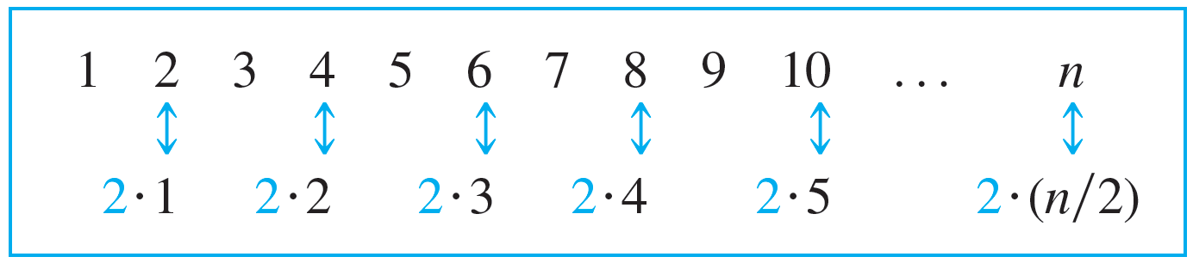
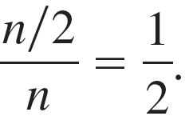
Example 9.1.5 – Solution
continued
b. (i) If n is even, each even subscript starting with 2 and ending with n can be matched up with an integer from 1 to n ∕ 2.
So there are n ∕ 2 array elements with even subscripts. Since the entire array has n elements, the probability that a randomly chosen element has an even subscript is

Slide 26
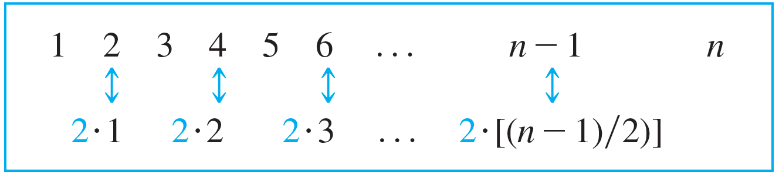
Example 9.1.5 – Solution
continued
(ii) If n is odd, then the greatest even subscript of the array is n − 1. So there are as many even subscripts between 1 and n as there are from 2 through n − 1.
Then the reasoning of (i) can be used to conclude that there are (n − 1) ∕ 2 array elements with even subscripts.

Slide 27
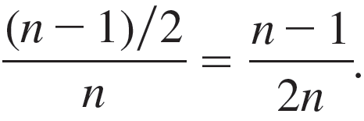
Example 9.1.5 – Solution
continued
Since the entire array has n elements, the probability that a randomly chosen element has an even subscript is
Observe that as n gets larger and larger, this probability gets closer and closer to 1 ∕ 2.

Slide 28
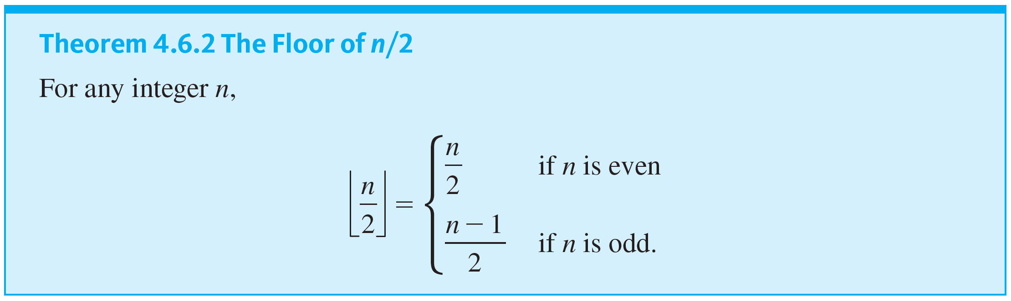
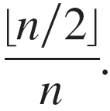
Example 9.1.5 – Solution
continued
Note that the answers to (i) and (ii) can be combined using the floor notation.
By Theorem 4.6.2, the number of array elements with even subscripts is ⌊n ∕ 2⌋ , so the probability that a randomly chosen element has an even subscript is

